Slide 1
Parking Spot
Rizwan Haider
F2023065277
Software Engineering
Submitted to: Dr. Kinza Sardar

Slide 2
Introduction
Project Name: Parking Spot: A Smart Parking Assistance System
Overview: This app is designed to help drivers efficiently locate legal parking spots, reserve place in parking area, locate parked vehicles, and secure vehicles with anti-theft features.
Objective: To reduce the time spent searching for parking spots, improve convenience for drivers, and enhance vehicle security in urban areas.
Target Users: Drivers seeking parking, vehicle owners concerned about theft or fines, and parking administrators.

Slide 3
Requirements (Functional and Non-Functional)
Functional Requirements:
User:
Sign Up
Login
Search for available parking spots
Reserve a parking spot in advance
Track parked vehicle location
Turn on/off anti-theft mode
Admin:
Separate admin login
View all users and parking spot data
Manage Parking Spot
Generate reports on parking usage, revenue, etc.
Non-Functional Requirements:
Performance: The app should respond to user queries within 3 seconds.
Security: User data and payment information must be securely encrypted.
Scalability: The system should be able to handle a growing number of users and parking locations.
Availability: The system should be available 24/7, with minimal downtime.

Slide 4
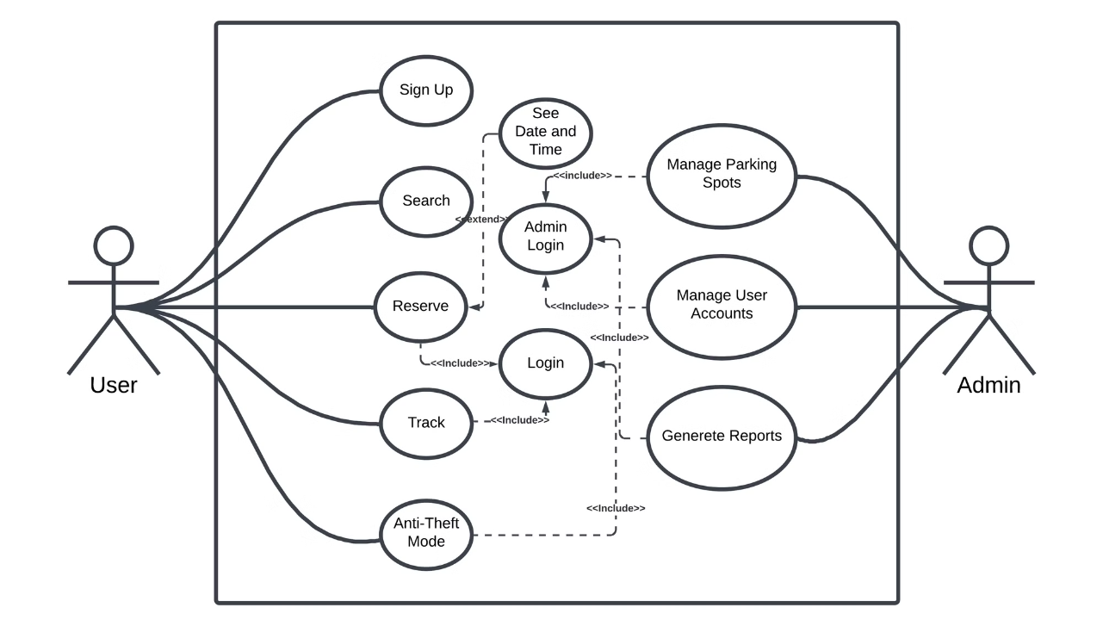
Use Case Diagram

Slide 5
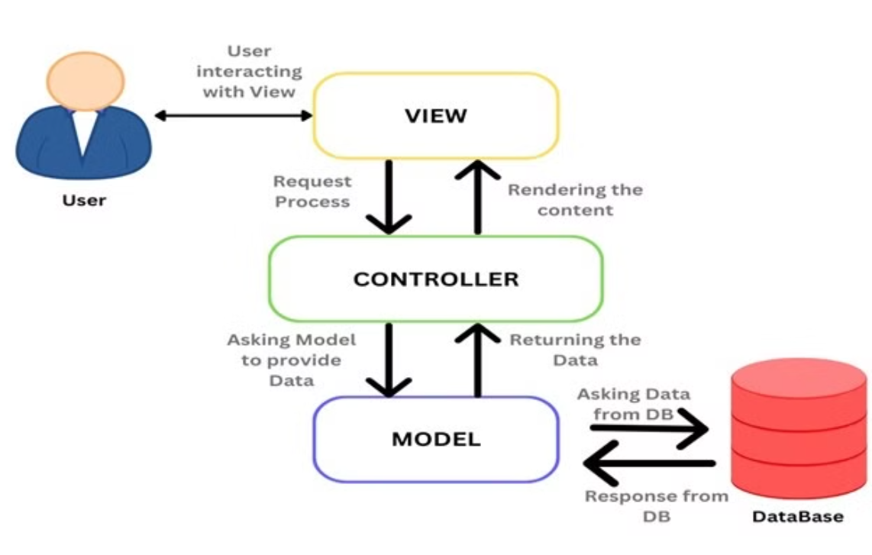
Architecture Diagram MVC

Slide 6
A Smart Parking Assistance System. MVC is a widely used architectural pattern that separates the application into three interconnected components, making it easier to manage, scale, and maintain the system.
How MVC fits into your project:
Model (Data Layer)
Represents the data and business logic of the system.
In your case, it would handle data such as user information, parking spot availability, reservations, payments, vehicle tracking, and anti-theft functionality.
The Model would interact with the Database to store and retrieve information about parking spots, users, transactions, etc.
Example: ParkingSpot, User, Reservation, and Payment classes that manage data and logic.
View (User Interface Layer)
Responsible for rendering the data to the user and providing a way for users to interact with the system.
For the User App, this could include screens for searching for parking spots, making reservations, tracking the vehicle, and managing the anti-theft system.
For the Admin Dashboard, it could include interfaces for managing parking spots, viewing user data, generating reports, etc.
The View only focuses on how data is presented and doesn't contain business logic.
Controller (Application Layer)
Acts as an intermediary between the Model and the View.
It handles the input from the user (via the View), processes it (using the Model), and returns the appropriate output (back to the View).
The Controller contains the business logic for handling user actions like logging in, searching for parking spots, making reservations, processing payments, and activating anti-theft features.
Example: A ParkingController that handles requests like reserving a parking spot, a UserController that handles user login, or a ReservationController that handles creating and updating reservations.
MVC Workflow for Your System:
User Interaction:
The User or Admin interacts with the View (e.g., the mobile app or web dashboard).
Controller Handling:
The Controller receives the user input (such as a parking spot search or reservation request).
The Controller invokes the necessary Model (e.g., fetching available parking spots, processing payment, updating reservation data).
Model Processing:
The Model handles the business logic, such as checking parking availability, making reservations, processing payments, or updating anti-theft status.
It retrieves or stores data in the Database as needed.
View Update:
The Controller passes the processed data back to the View, which updates the user interface to reflect the results (e.g., showing available parking spots, confirming the reservation, displaying payment confirmation).
Example for MVC in Your Parking System:
Model:
ParkingSpot Model: Defines properties like spot ID, location, availability, and pricing.
User Model: Contains user-specific information like name, email, and parking history.
Reservation Model: Manages parking reservations with fields like start time, end time, parking spot ID, and user ID.
Payment Model: Handles payment data, including amount, payment method, and transaction status.
View:
Mobile App UI (User): Interface for users to search for available spots, reserve a spot, and view payment details.
Admin Dashboard UI: Web interface for admins to manage parking spots, users, generate reports, etc.
Controller:
ParkingController: Handles user requests for searching and reserving parking spots.
UserController: Manages user authentication (login, signup).
PaymentController: Handles payment processing (integrating with the payment gateway).
Benefits of Using MVC in Your Project:
Separation of Concerns: It allows you to separate the application logic (Model), user interface (View), and business processing (Controller), making your code easier to maintain and update.
Scalability: As your project grows, it becomes easier to extend and scale the system by adding new features, such as adding new payment methods or integrating more security features.
Testability: Since the components are decoupled, it becomes easier to write unit tests for each component (Model, View, and Controller) independently.
Conclusion:
MVC is a good architectural choice for your Parking Spot System. It will allow you to manage different parts of the system independently (e.g., user interface, data management, and business logic), making it more maintainable, scalable, and easier to understand. You can implement it effectively by dividing your system's responsibilities according to the Model, View, and Controller components.

Slide 7
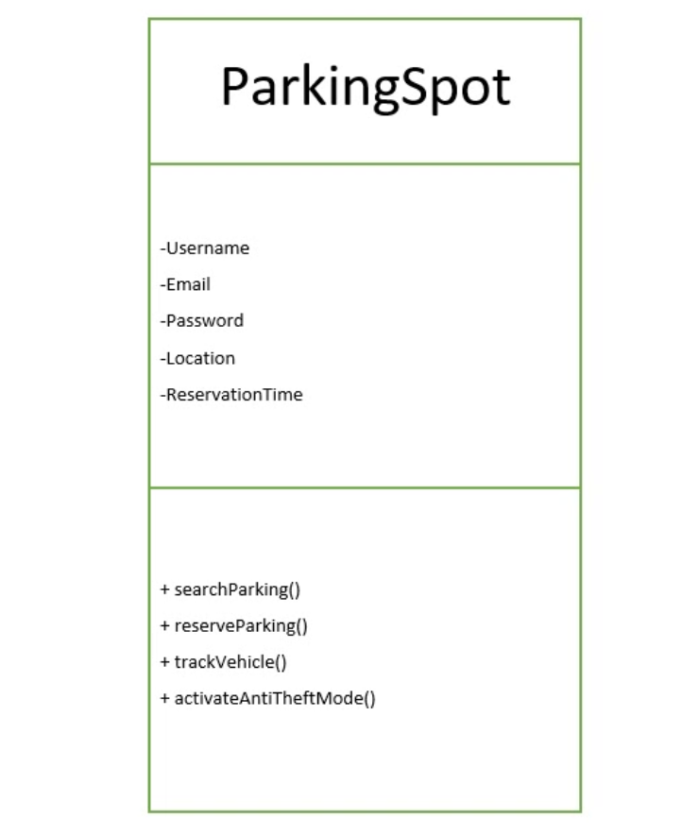
Class Diagrams

Slide 8
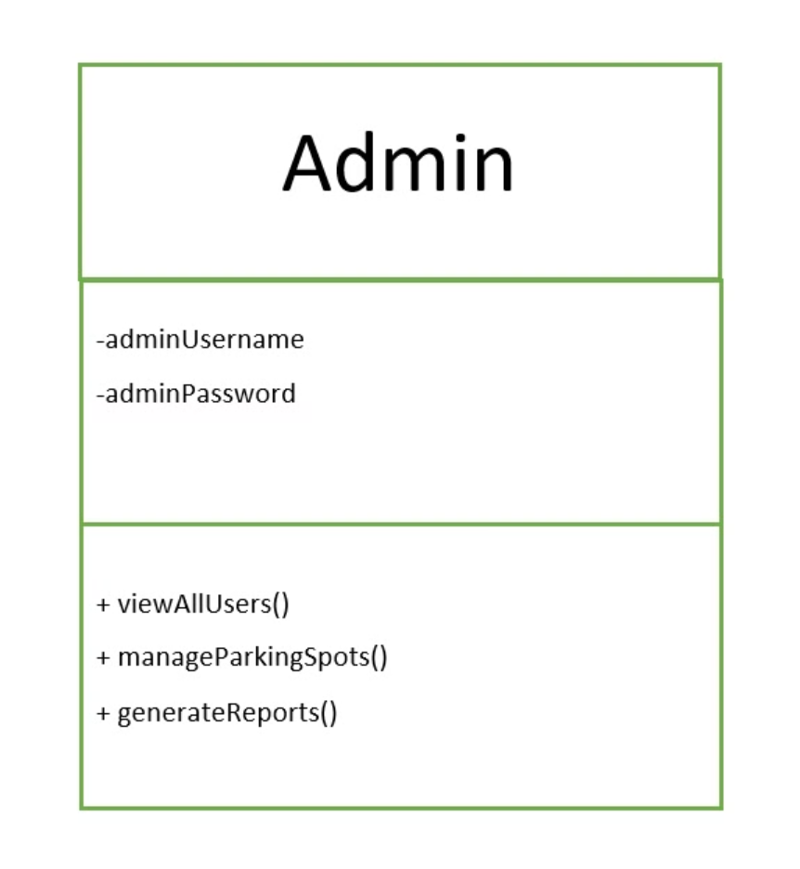

Slide 9
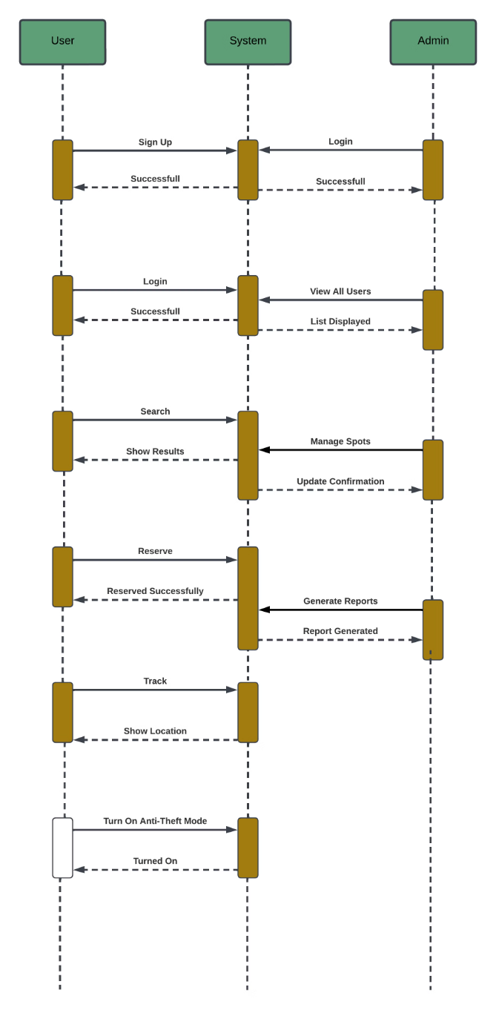
Sequence Diagram

Slide 10
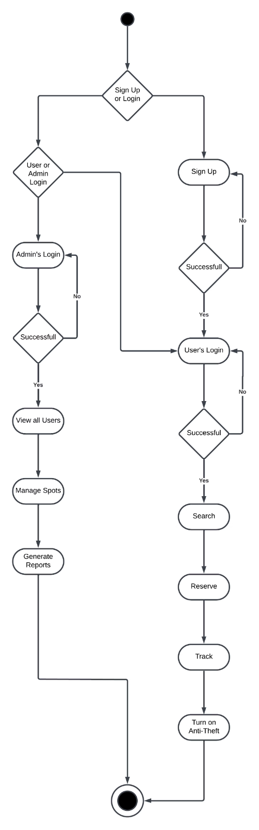
Activity Diagram

Slide 11
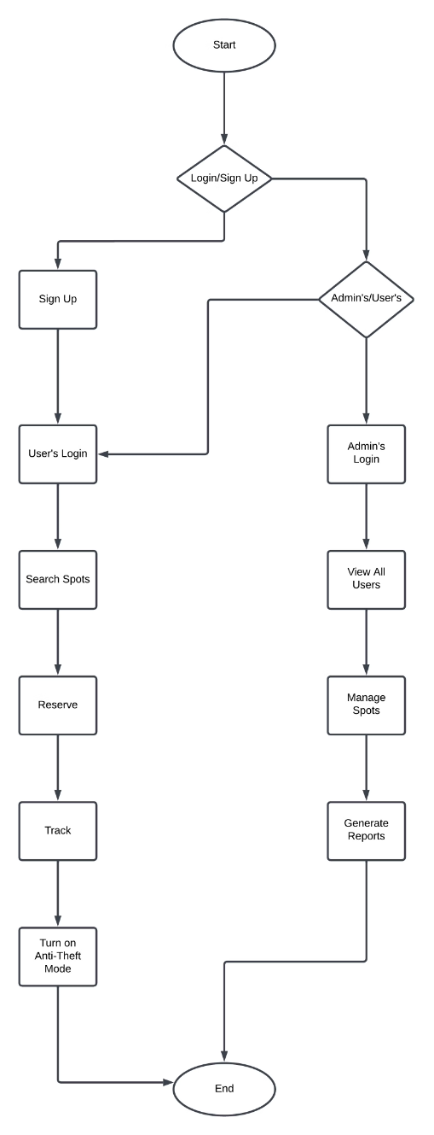
Flowchart

Slide 12
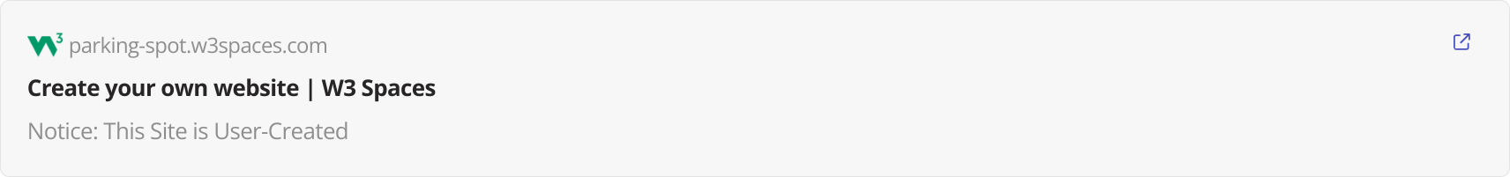
Prototype
parking-spot.w3spaces.com

Slide 13
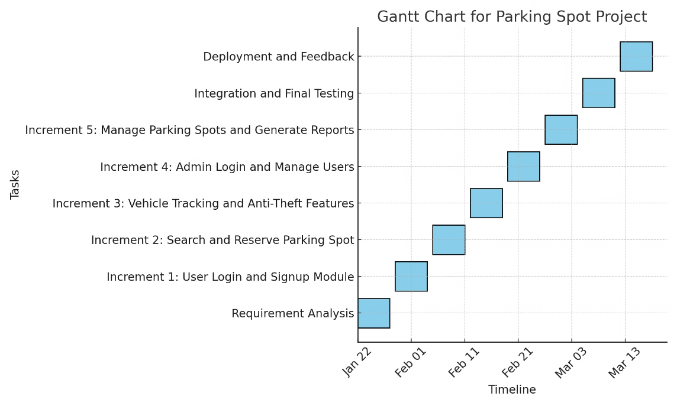
Gantt Chart

Slide 14
WPS (Work Breakdown Structure)
Project Initiation:
Define project goals and requirements
Assemble project team
System Design:
Create use case, sequence, and class diagrams
Design system architecture
Develop database schema
Development:
Develop user and admin functionalities
Implement payment integration
Build anti-theft features and location tracking
Testing:
Perform unit testing for individual components
Conduct integration testing for system interactions
Deployment:
Deploy the application on cloud servers
Set up the production environment
Maintenance:
Provide ongoing support and bug fixes
Implement periodic system updates and feature enhancements

Slide 15
Testing
Unit Testing: Focus on testing individual components like login, parking spot search, reservation, and anti-theft features.
Integration Testing: Ensure that different modules work together seamlessly, such as the interaction between the reservation system and payment processing.
System Testing: Verify that the entire system functions as expected, ensuring all features (user login, search, reservation, etc.) work in real-world scenarios.
Acceptance Testing: Validate that the system meets the user's needs and performs as expected in a production environment.
Performance Testing: Ensure the system can handle the expected load, with optimal response times even during peak usage.

Slide 16
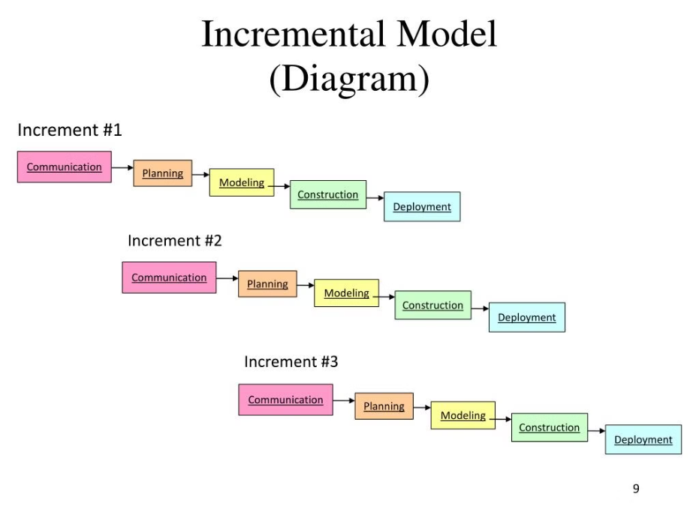
SDLC

Slide 17
Conclusion
The Parking Spot app is designed to solve common parking issues by providing real-time information about available spots, ensuring smoother parking experiences for drivers. The system also focuses on enhancing vehicle security through anti-theft features.
The project aims to reduce the time spent searching for parking, thus improving the overall efficiency of urban mobility.
With a solid system design, detailed testing, and comprehensive features for both users and admins, the Parking Spot app has the potential to become a reliable and innovative solution in smart parking assistance.

